Slide 1

Google Colab
Jillian Hebert
April 30, 2020

Slide 2
Overview
About
Tips
Advantages
Disadvantages

Slide 3

Google Colab
Browser access
  Cloud service Jupyter Notebooks
Mounts to a Google Drive account
Free
  With limits

Slide 4
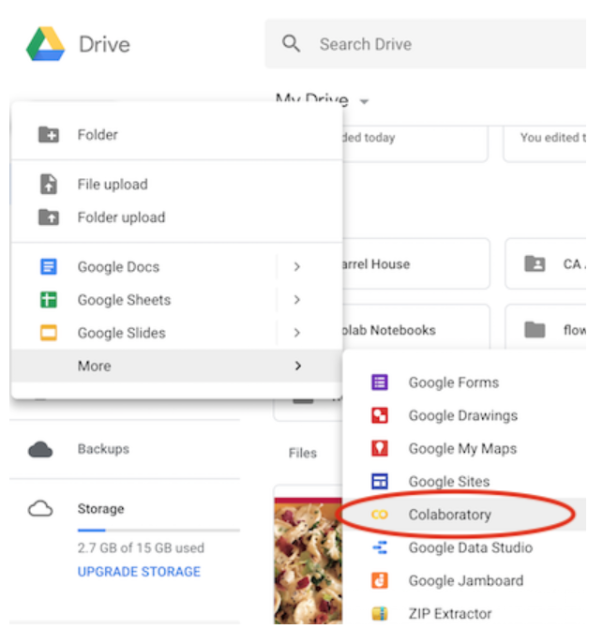
About Google Colab
Supports Python 2.7 and 3.6
  R and Scala are currently still unavailable
  Supports add-ons like PyTorch, Keras, and OpenCV
Mountable to Google Drive accounts
  Create, store, and share notebooks
  Create new → More → Colaboratory
  Access datafiles stored in Google Drive
https://towardsdatascience.com/getting-started-with-google-colab-f2fff97f594c

Slide 5
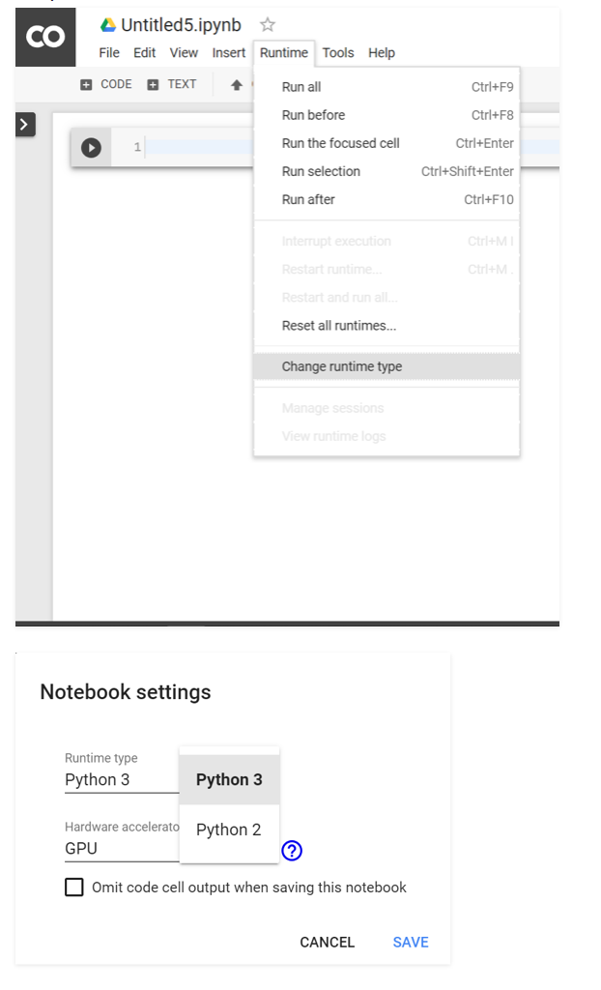
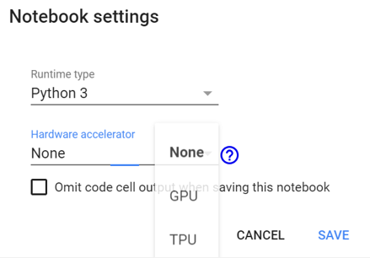
Getting Started
Name notebooks
Change runtime (version)
  Python 2 or Python 3
Change hardware accelerator (compiler)
  GPU, TPU, or None
Chunk types
  Headers
  Code
  Text

Slide 6
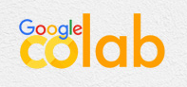
Tips and Tricks
Mount Google Drive
  From google.colab import drive
    File → Mount Drive
Connect to GitHub
  Tools → Preferences → Copy GitHub link
Download notebooks as Python files or notebooks
Sharing features
Dark mode
  Tools → Preferences → Theme
Undo accidentally deleting a cell
  Ctrl + Shift + Z
Find and replace
  Ctrl + H
Keyboard Shortcuts
  Ctrl + M + H
https://medium.com/secure-and-private-ai-writing-challenge/super-cool-10-hidden-features-in-google-colab-584dacb30ea4

Slide 7
Let’s check it out!

Slide 8

Advantages
Free
Online but mountable
Easily sharable
  Working with others
  Distributing a final project
Nicely formatted
Benefits of Google Drive
  Autosave
  Sharing (with restrictions)
  Commenting

Slide 9

Disadvantages
Usage and storage limits
  Hardware availability fluctuates
Need to install libraries
Doesn’t handle big datasets well
Certain code formats won’t run
Time out
  Connects to Google Drive for 30 minutes
  Connects to Google Colab for 12 hours
    Save data frames

Slide 10


